Slide 1
Ward Department
TEMPLATES

Slide 2
Templates Name
1
Dialysis Template

Slide 3
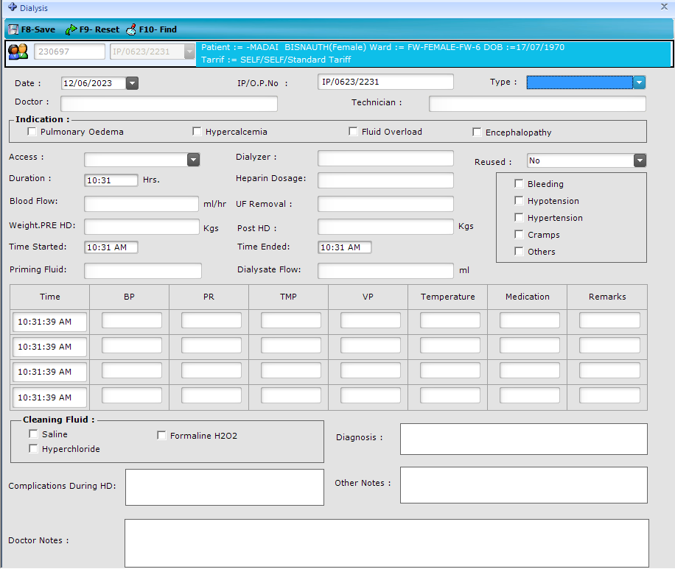

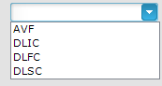

Slide 4
Templates Name
2
NICU Monitoring Chart

Slide 5
